Slide 1

Team The Rebel Alliance
Team member: PRITI Sharma & Tingjia Zhang
Professor: Andrew bond

Slide 2

Project Perspective
This project will be based on the default project
Build an enterprise application that provides Information management system
There are two main functions supported by this application:
Let the users register accounts in different roles.
All registered users can upload their information.
Normal users can upload feedback to backend.
Manager can upload rate feedback to normal user.
Manager can search and look the normal user information.

Slide 3

Roles
1.Employee
Permission to write
2.Manager
Permission to write and read
-----------------------------------------------
To be complete in the future:
3.Root Admin:
Permission to write, read and modify.

Slide 4

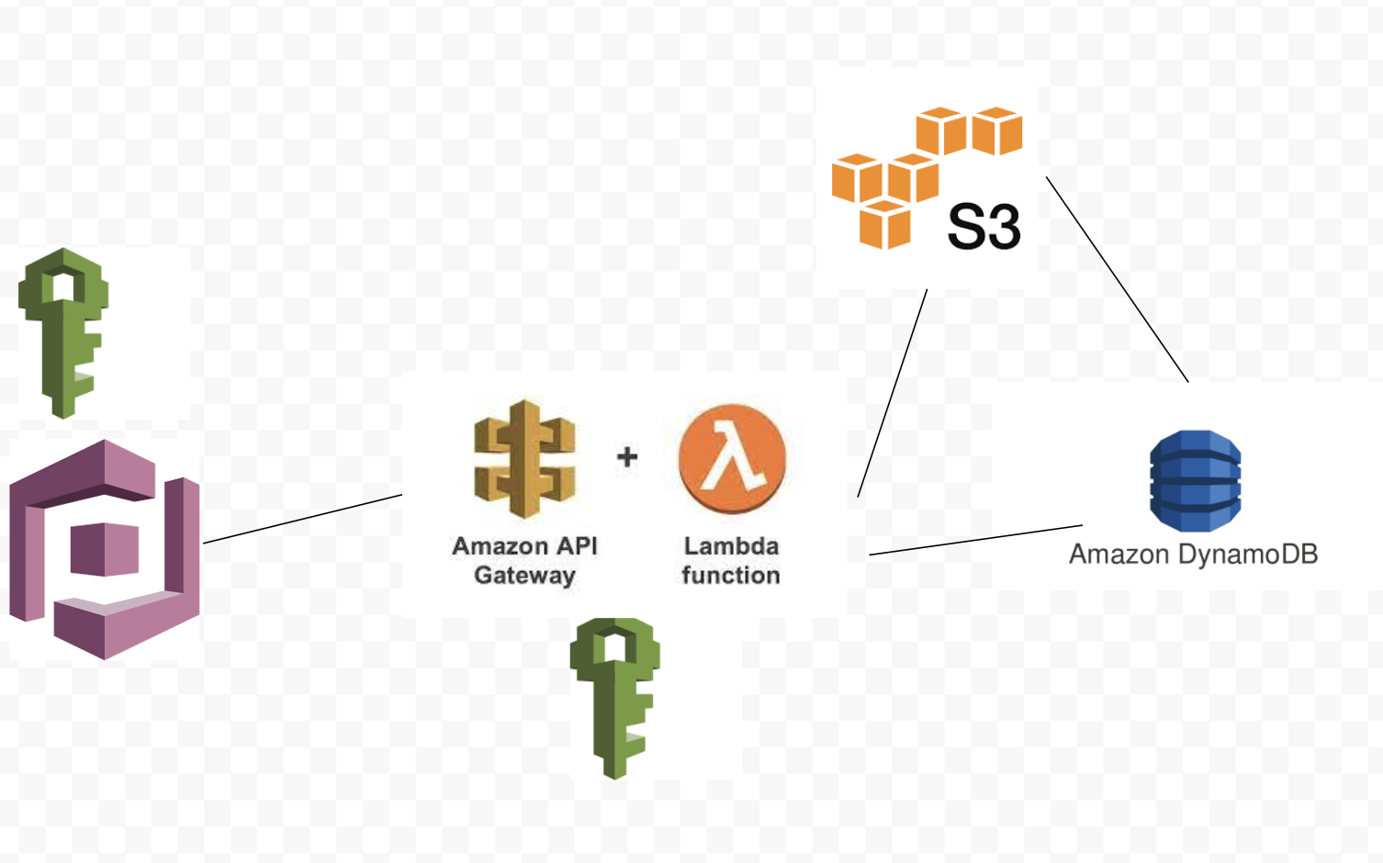
Aws Service:
IAM
S3 BUCKET
Cognito
API Gateway
Lambda
DynamoDB

Slide 5

dEMO

